Slide 1
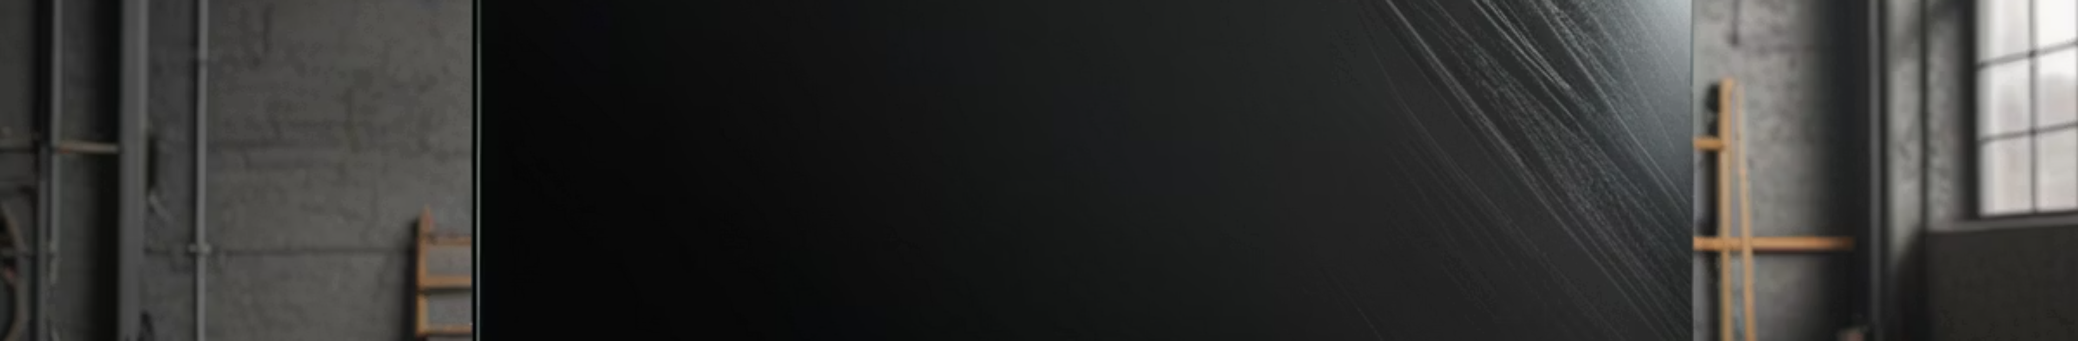

Project Definition and Achievements
Project Goal: To create realistic synthetic datasets for training Quality Assurance models though the use of image generation.
Achievements:
Developed four-stage pipeline: Base Generation, Smart Labeling/Masking, Defect Injection, and Perspective Rectification.
Scale of Success: Generated a dataset of 7,200 images.
Successfully classified five distinct classes: (Good, Spiderweb, Scratch, Shattered Corner, and Puncture) with 99.03% accuracy.
Novelty: comparative analysis between models trained on Raw vs. Rectified images

Slide 2
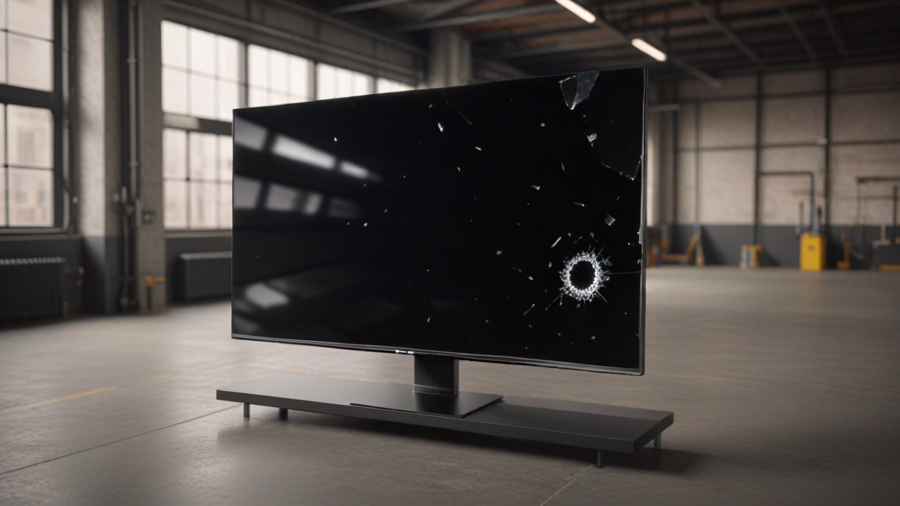
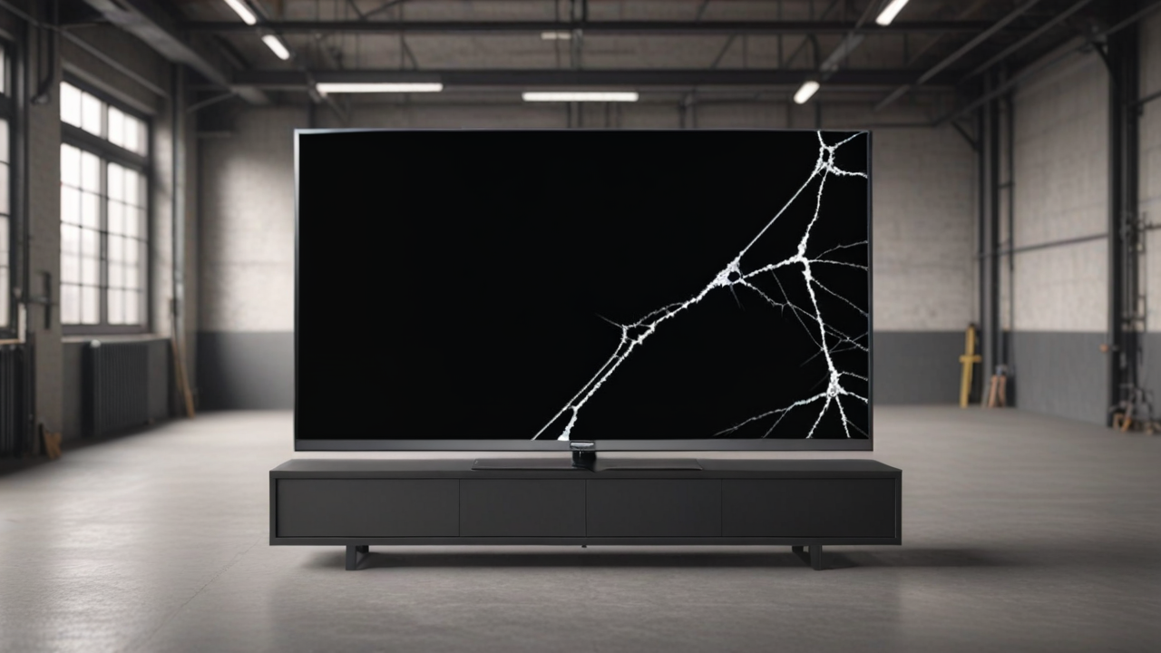

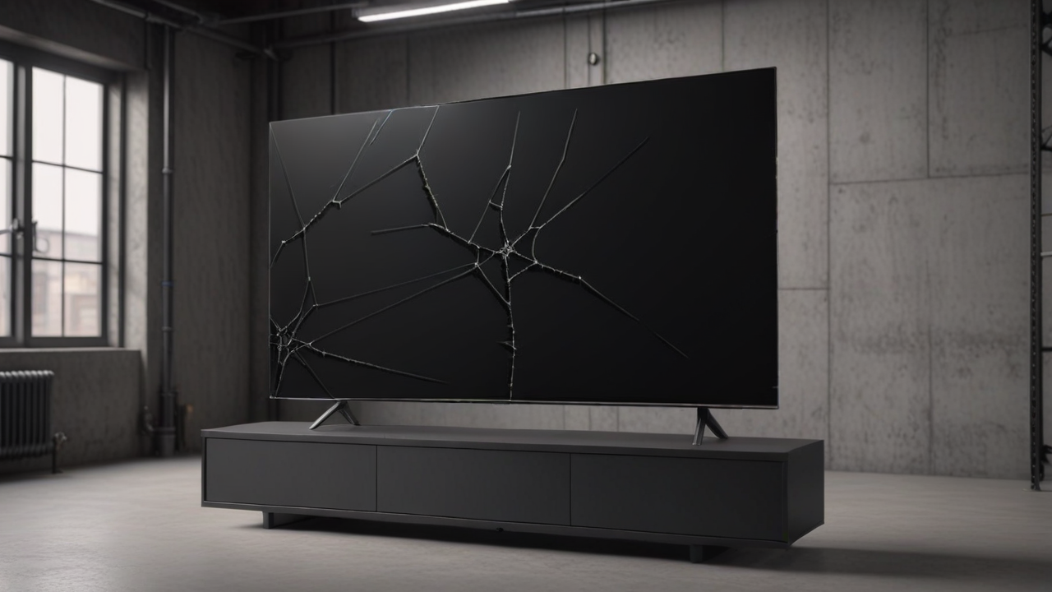
Puncture
Shattered corner
Scratch
Spiderweb crack

Slide 3
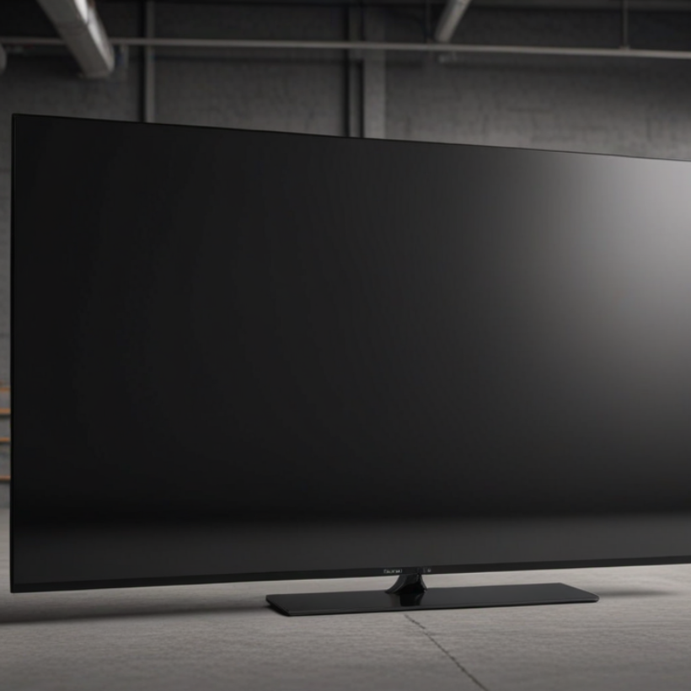
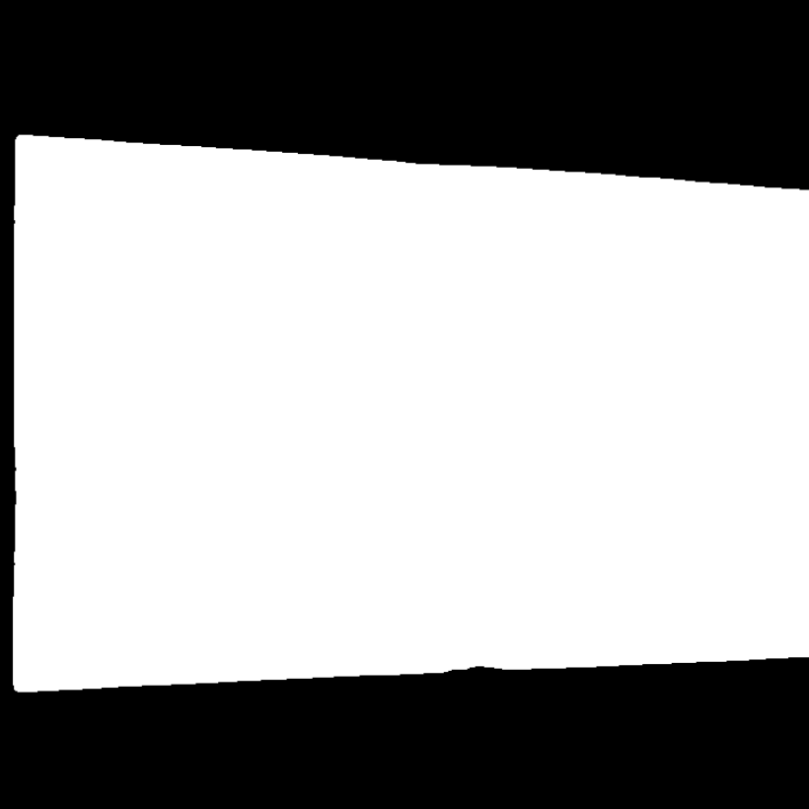
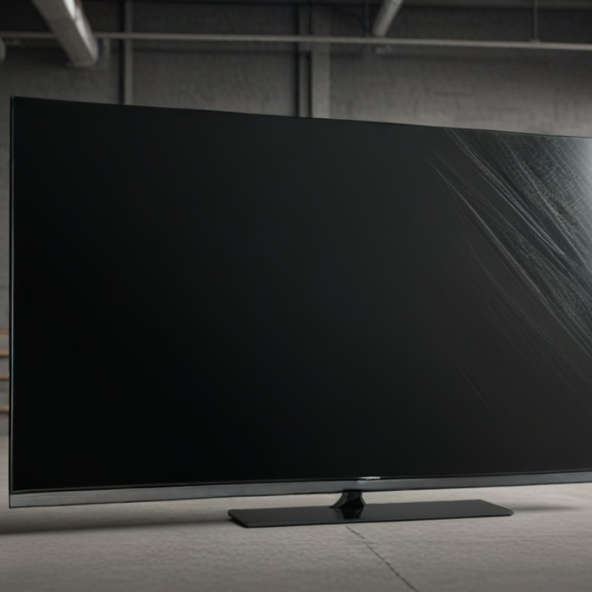
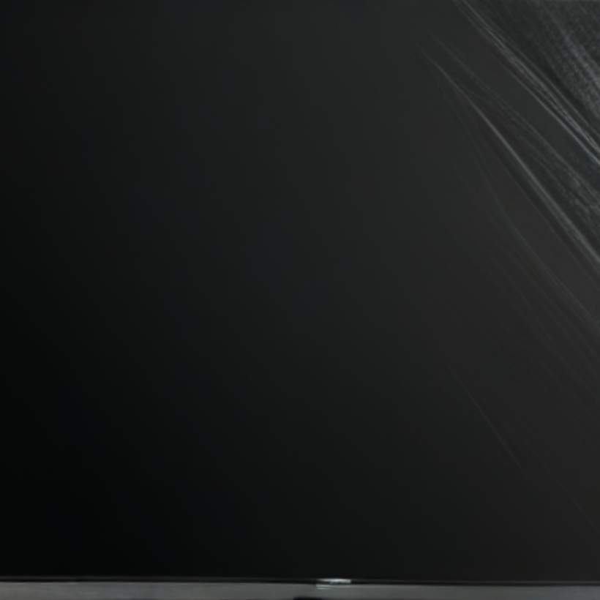
Data Preparation and Quality Efforts
Dataset Composition: We generated a total of 7,200 images: 3,600 Base Images and 3,600 Defected Images (900 for each of four defect categories).
Synthetic Generation: SDXL Lightning was used to create base images of TVs in industrial environments.
Precision Masking: Combined OWLv2 for object detection and SAM for segmentation.
Perspective Rectification: A preprocessing script using OpenCV identified screen corners and applied perspective transformation for standardized, "flat" views.
The Good
The Mask
The Bad
The Ugly

Slide 4
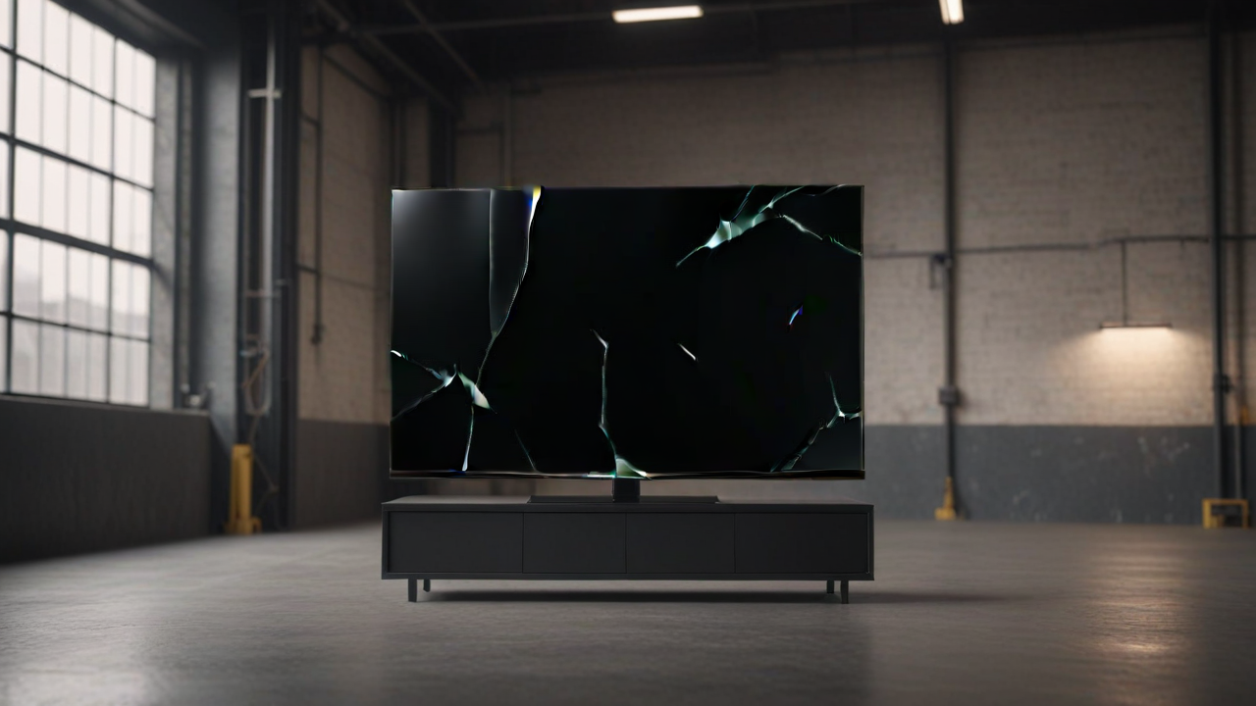
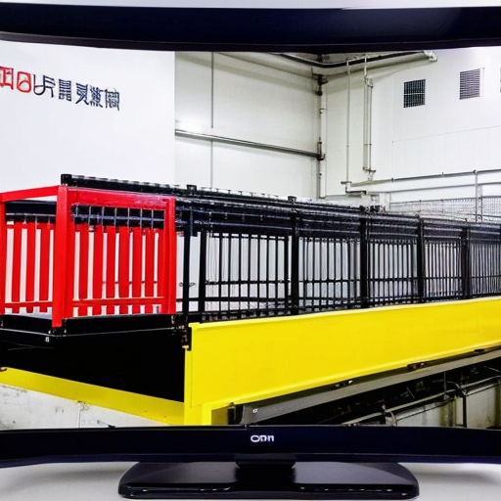
Fine-Tuning: Attempted to use Dreambooth to fine-tune a model on defect data, but the results did not meet quality standards.
Localized Inpainting: Tested inpainting in small, specific areas, which created unnatural artifacts and "bad" visual transitions.
Prompt Engineering: negative prompting ensured baseline screens were "clean" and suitable.
Dreambooth Failure
Without prompt engineering

Slide 5
Methodology and Results (Comparative Analysis)
#The core of our review is the comparison between the Raw Dataset (with backgrounds) and the Rectified Dataset (isolated screens).
Metric
Raw Dataset
Rectified Dataset
Top-1 Accuracy
99.09%
99.03%
Training Time (10 Epochs)
2318.97 s
1308.96 s
Best Accuracy Epoch
10
7
Validation Loss
0.0293
0.0346
Key Insight: The Rectification step proved critical, reducing training time by 43% while maintaining comparable accuracy

Slide 6
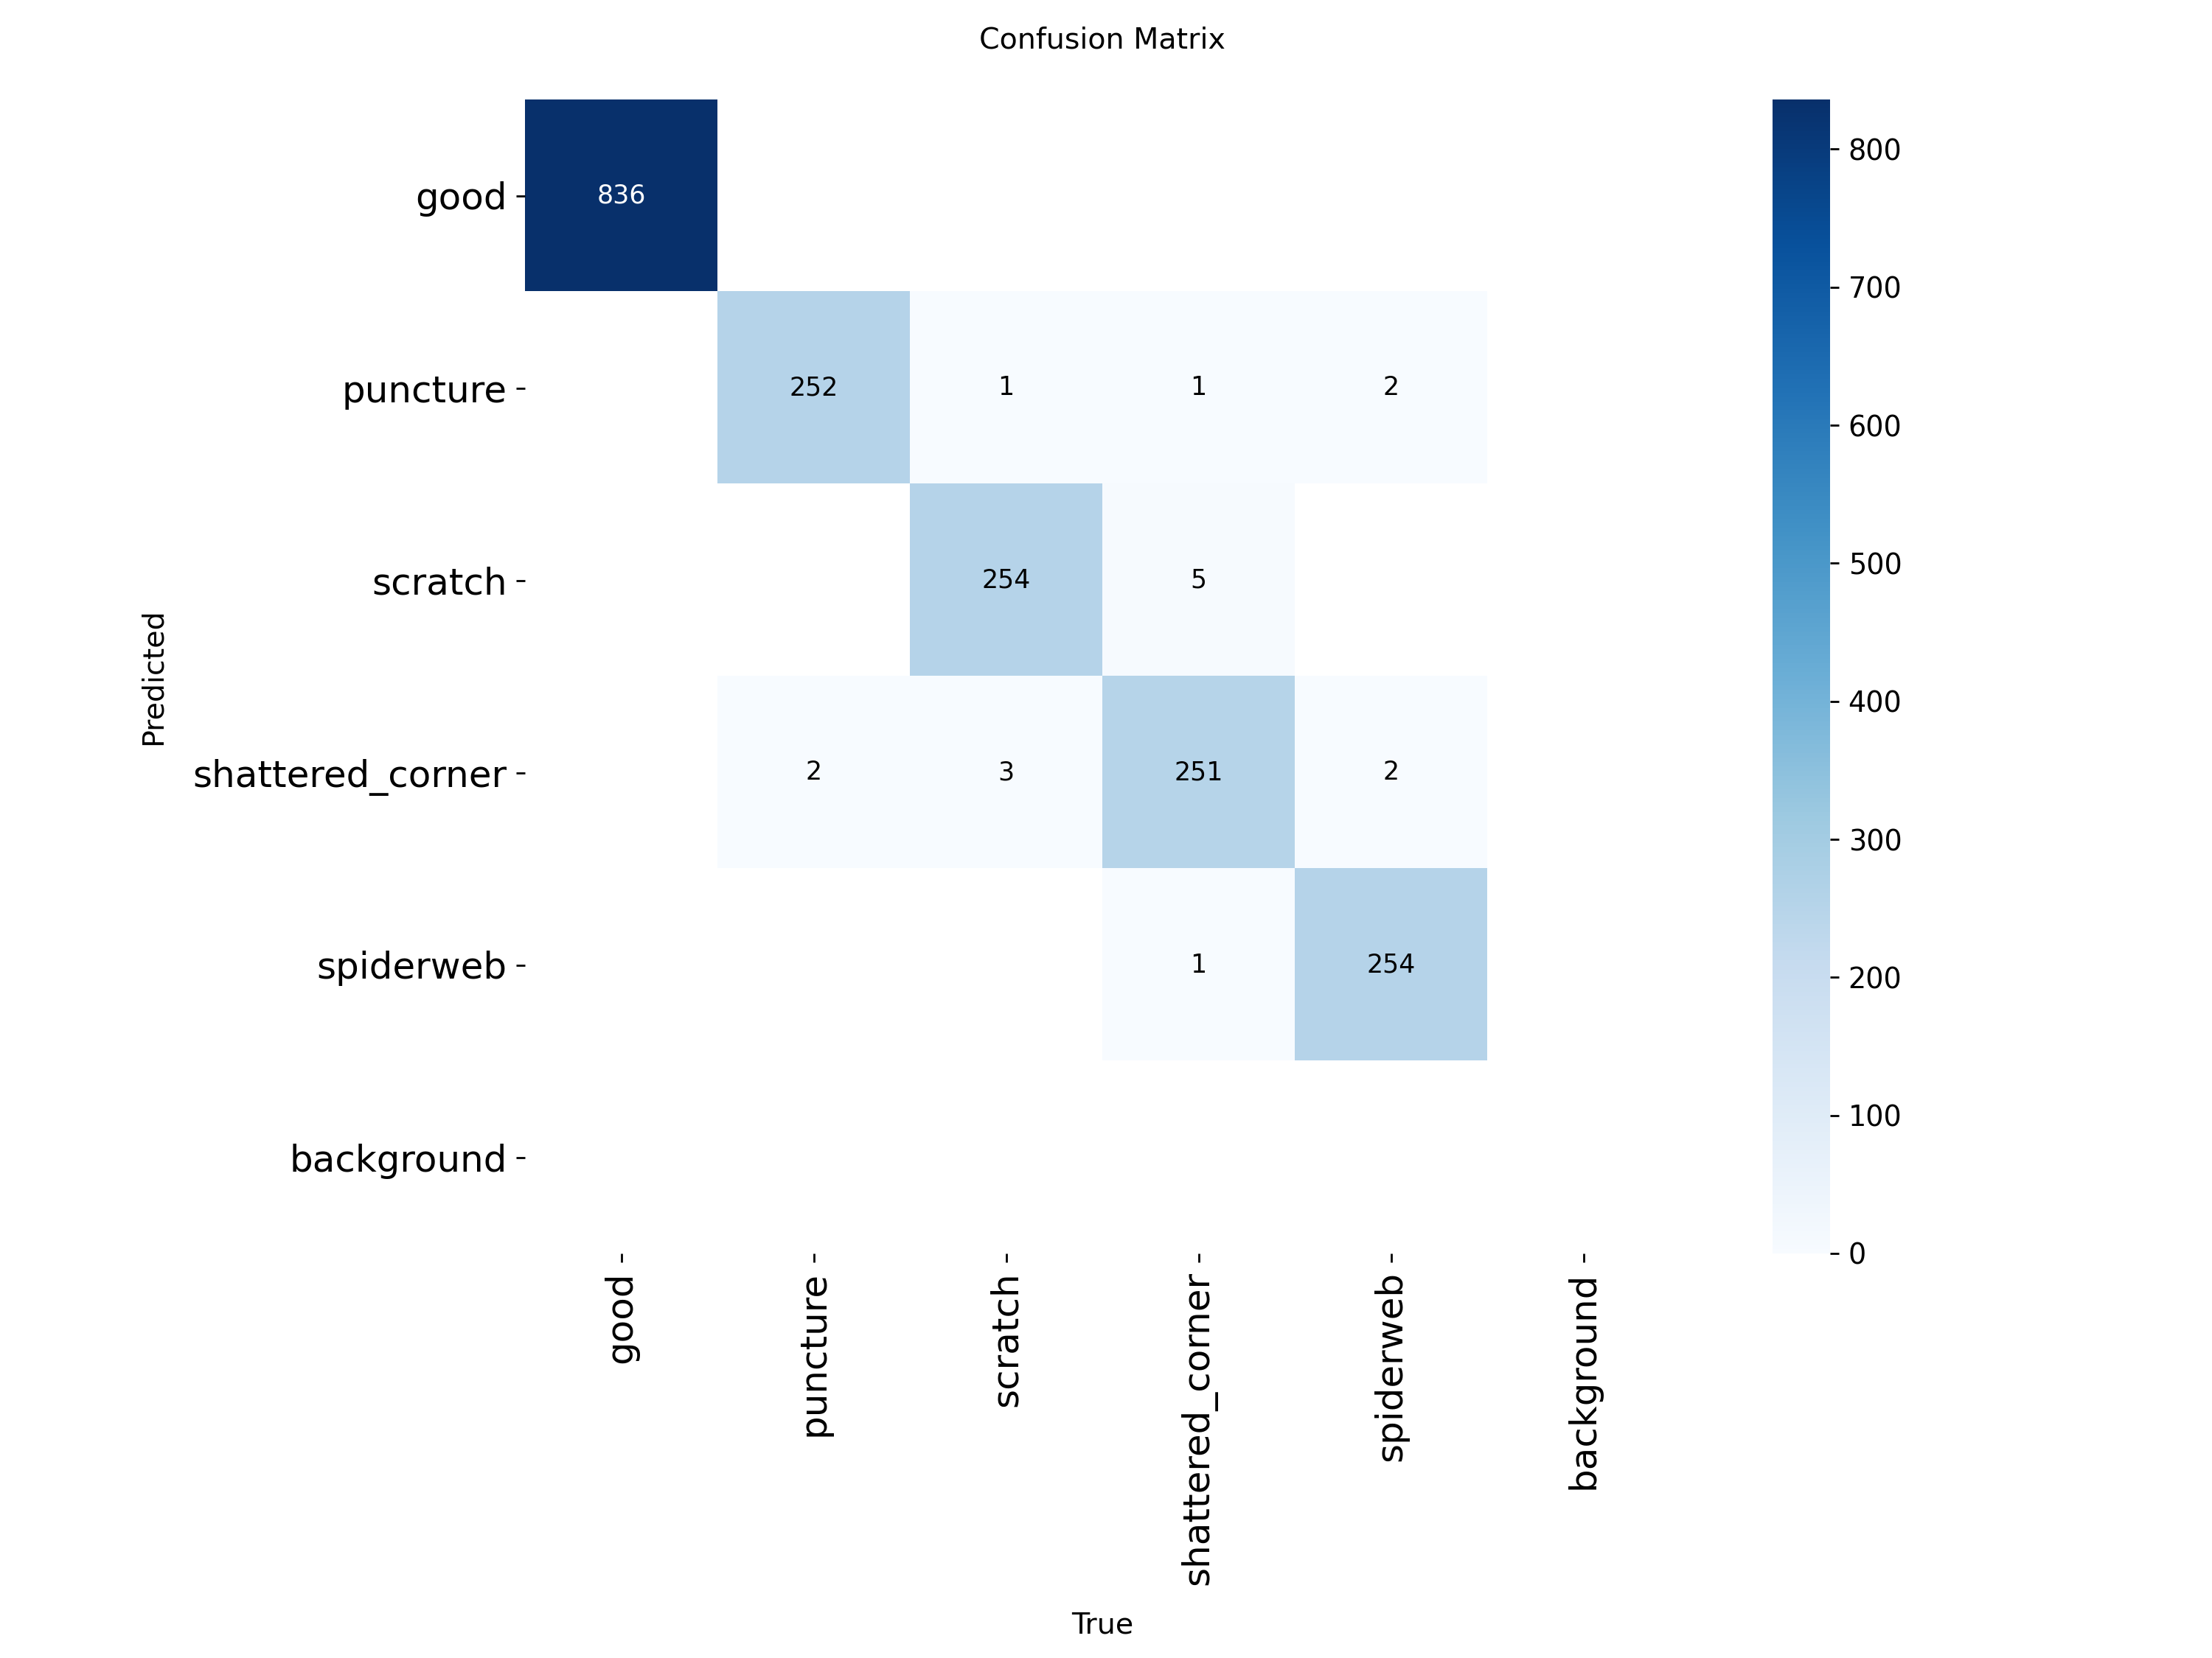
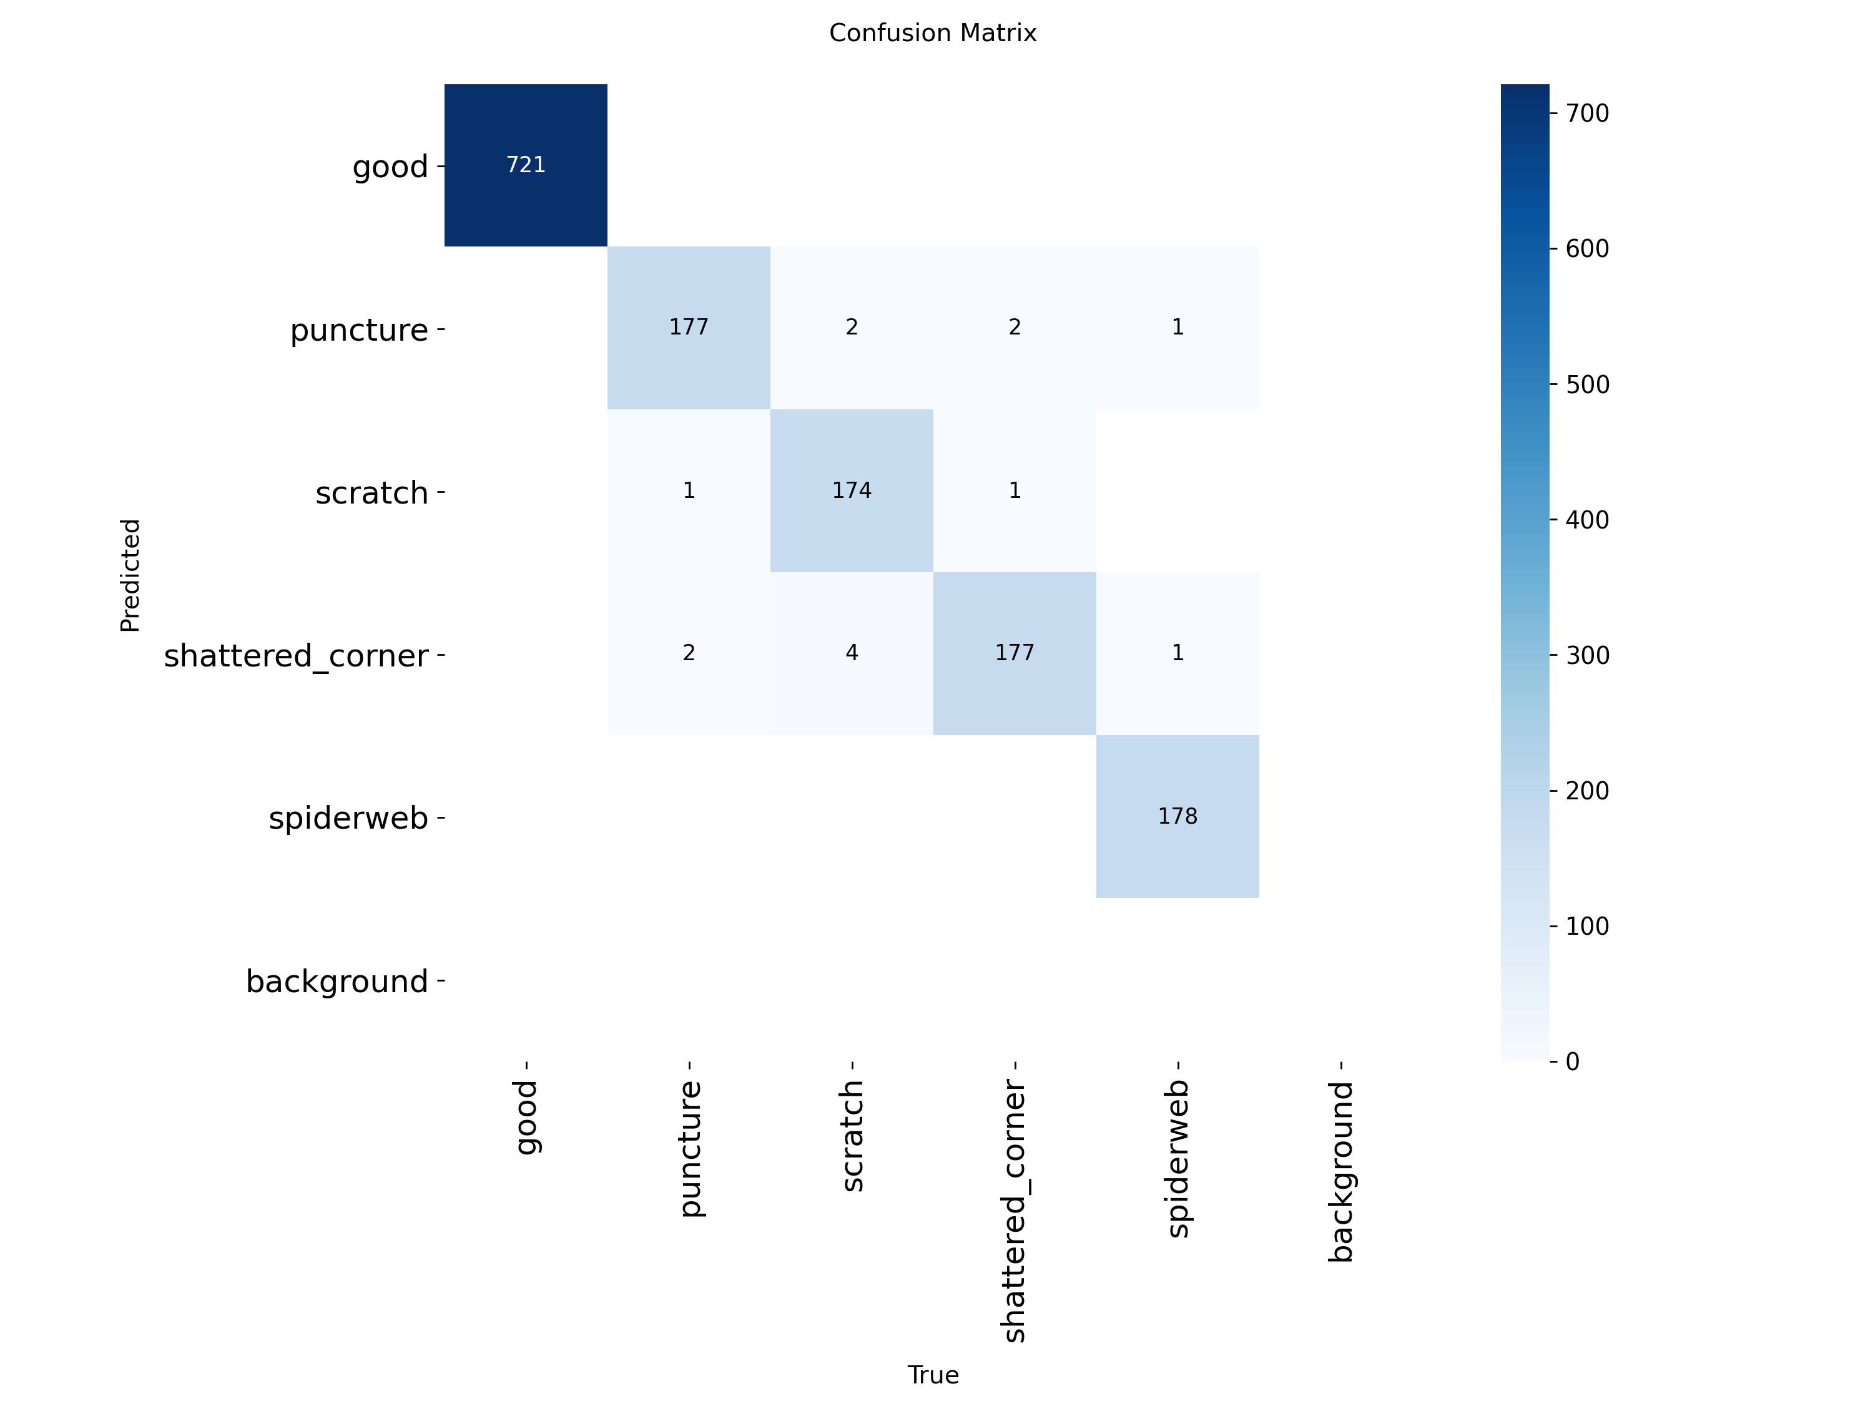
Raw pictures
Rectified pictures

Slide 7
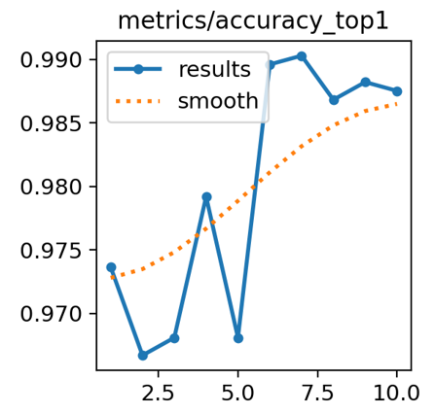
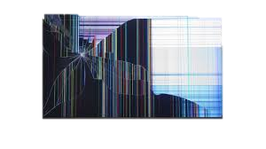

Conclusions and Future Directions
Desired Results | Lessons Learned | Future Ideas
Achieved near-perfect accuracy 99.03% | Perspective transformation enables faster convergence Generative AI can effectively bridge the "Data Scarcity" gap for rare industrial defects | Synthetic-to-Real Validation

